Slide 1
Nutrition Surveillance Data Tool
Tool #1: Customizable Compendium Table

Slide 2
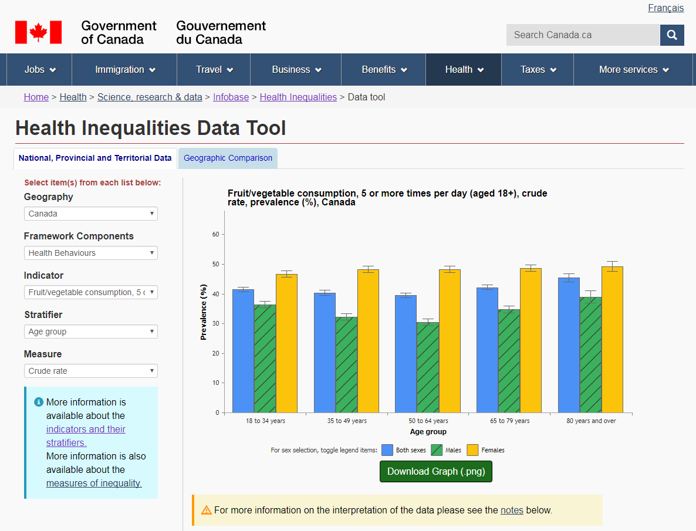
Revisions to the Infobase Health Inequalities Data Tool
Nutrition Surveillance Data Tool
Nutrient Intake Data
Customization Steps:
Nutrient
Geographic area
Year(s)
Age-sex group(s)
Data
This would be a customizable table
https://infobase.phac-aspc.gc.ca/health-inequalities/data-tool/

Slide 3
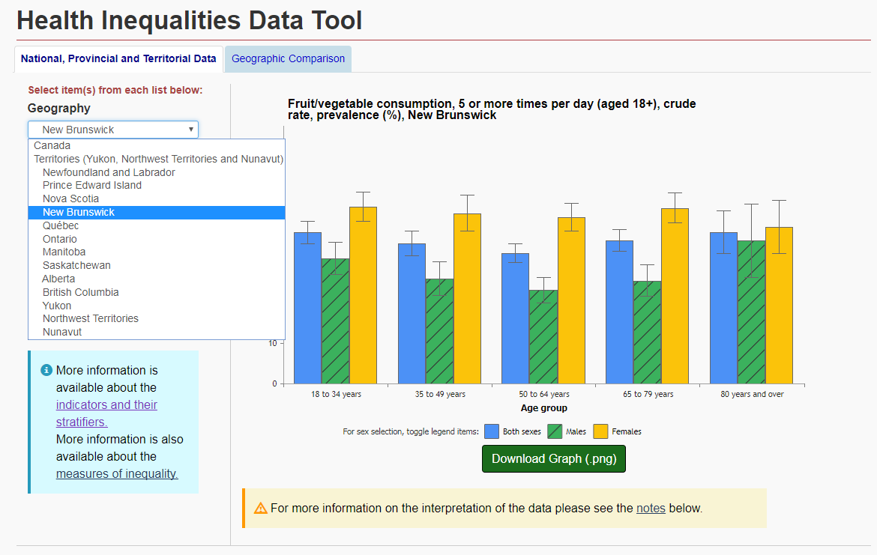
Customization Options: What we want for some customization steps
This would be a customizable table
Restricted to select only one option per customization step for:
Nutrient
Geographic area
Notes:
Options for nutrients:
Total energy intake (kcal/d)
Percentage of total energy intake from fats
Percentage of total energy intake from protein
Percentage of total energy intake from carbohydrates
Percentage of total energy intake from saturated fats
Percentage of total energy intake from monounsaturated fats
Percentage of total energy intake from polyunsaturated fats
Total dietary fibre (g/d)
Cholesterol (mg/d)
Total fats (g/d)
Total saturated fats (g/d)
Total sugars (g/d)
Sodium (mg/d)
Vitamin A (RAE/d)
Vitamin C (mg/d)
Folate (DFE/d)
Folacin (mcg/d)
Naturally occurring folate (mcg/d)
Niacin (NE/d)
Riboflavin (mg/d)
Thiamin (mg/d)
Vitamin B6 (mg/d)
Vitamin B12 (mcg/d)
Vitamin C (mg/d)– by smoking status
Vitamin D (mcg/d)
Calcium (mg/d)
Magnesium (mg/d)
Phosphorus (mg/d)
Potassium (mg/d)
Zinc (mg/d)
Moisture (g/d)
Protein (g/d)
Total carbohydrates (g/d)
Linoleic fatty acid (g/d)
Percentage of total energy intake from linoleic fatty acid
Linolenic fatty acid (g/d)
Percentage of total energy intake from linolenic fatty acid
Total monounsaturated fats (g/d)
Total polyunsaturated fats (g/d)
Iron
Alcohol
Caffeine
Options for geographic areas:
Canada
Newfoundland and Labrador
Prince Edward Island
Nova Scotia
New Brunswick
Quebec
Ontario
Manitoba
Saskatchewan
Alberta
British Columbia
Health Regions????

Slide 4
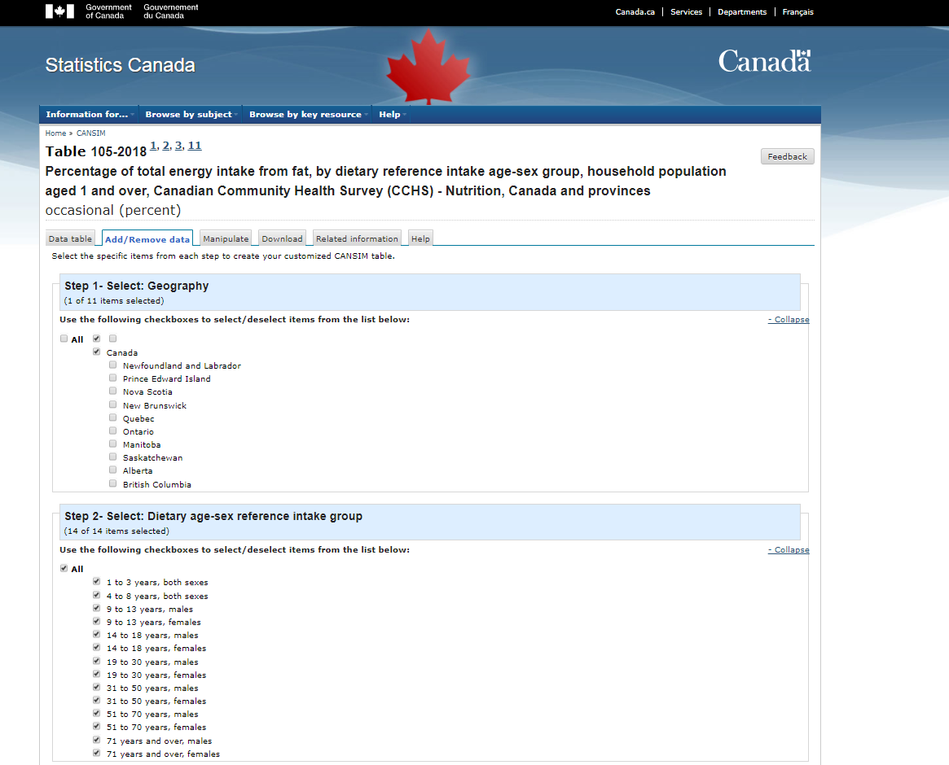
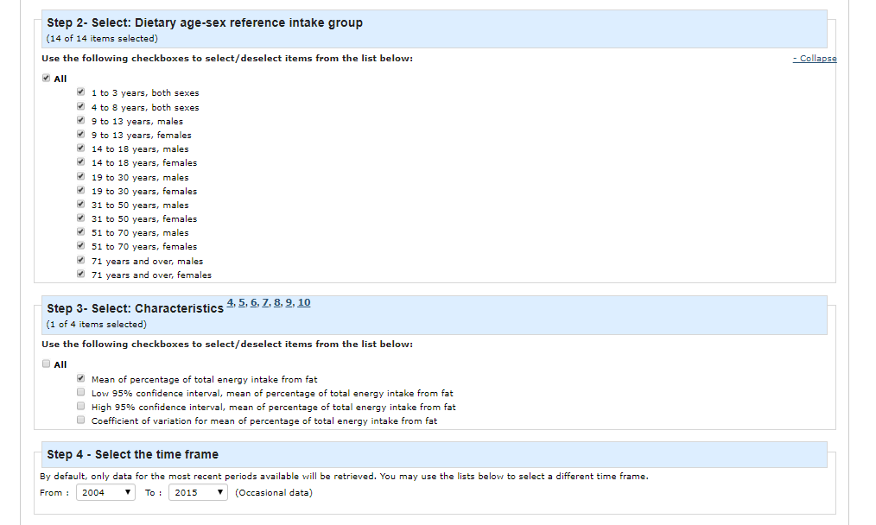
Customization Options: What we want for other customization steps
Ability to select multiple options per customization step:
Year(s)
Age-sex group
Data
Example: http://www5.statcan.gc.ca/cansim/a21
Notes:
Options for years:
2015
2004
Both
Options for Age-sex group:
1 to 3 years, both sexes
4 to 8 years, both sexes
9 to 13 years, males
9 to 13 years, females
14 to 18 years, males
14 to 18 years, females
19 to 30 years, males
19 to 30 years, females
31 to 50 years, males
31 to 50 years, females
51 to 70 years, males
51 to 70 years, females
71 years and over, males
71 years and over, females
19 years and over, males
19 years and over, females
Options for Data:
Mean and standard error of intake
Percentage of population above adequate intake (AI) with standard error estimate*
Percentage of population above estimated average requirement (EAR)*
Percentage of population above tolerable upper intake level (UL) *
Percentage of population within acceptable macronutrient distribution range (AMDR) *
Percentage of population above acceptable macronutrient distribution range (AMDR) *
P-value AI**
P-value EAR**
P-value UL**
*options should appear based on which nutrient is selected (e.g. for sodium the AI and UL should appear whereas for percentage of total energy intake from fat only the AMDR options should appear)
**only available if user selects both 2004 and 2015 and options should appear based on which nutrient is selected

Slide 5
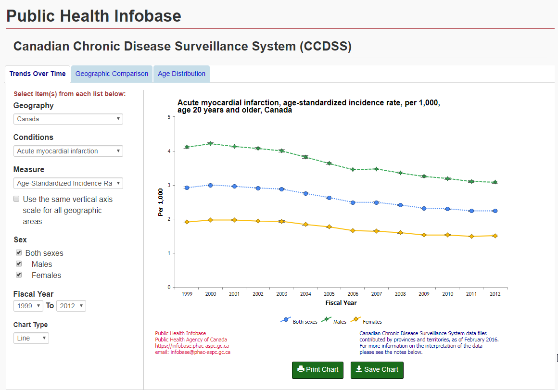
Customization Options: What we want for different customization steps
Dropdown menu restricted to select only one option per customization step for:
Nutrient
Geographic area
Ability to select multiple options per customization step:
Year(s)
Age-sex group
Data
https://infobase.phac-aspc.gc.ca/ccdss-scsmc/data-tool/
Notes:
Another option that shows both customization options (dropdown menu and check boxes) on the same data tool.

Slide 6
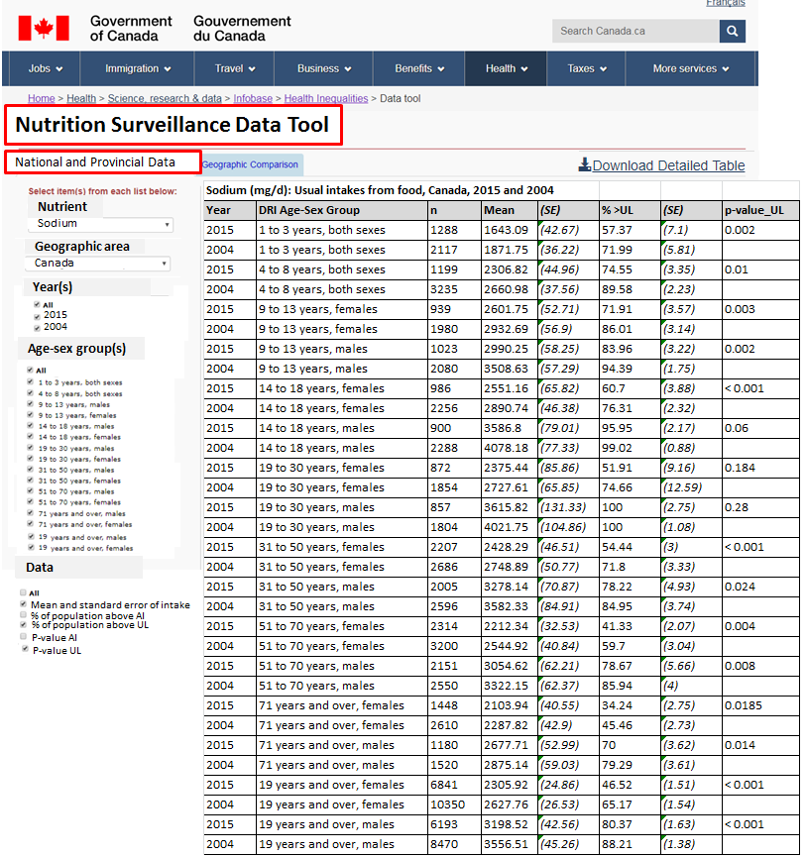
Final product example #1
Nutrient Intake Data

Slide 7
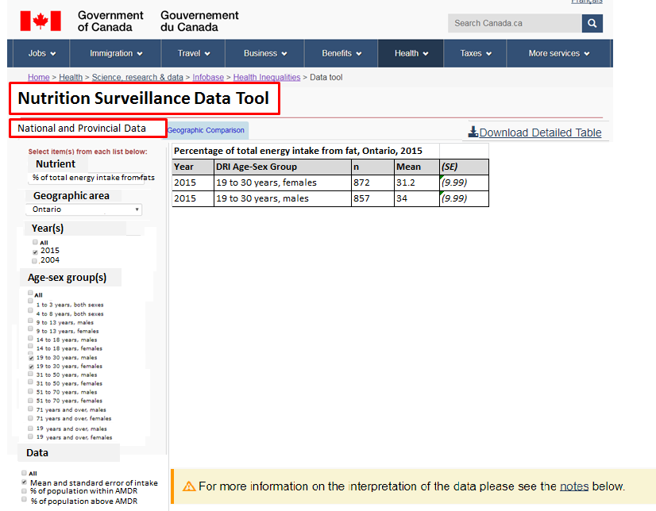
Final product example #2
Nutrient Intake Data

Slide 8
Nutrition Surveillance Data Tool
Tool #2: Intake Distribution Graphs
Similar customization steps to Tool #1 with the following modifications:
  Exclude the customization step for “Data”
  Age-sex as a single option drop-down menu

Slide 9
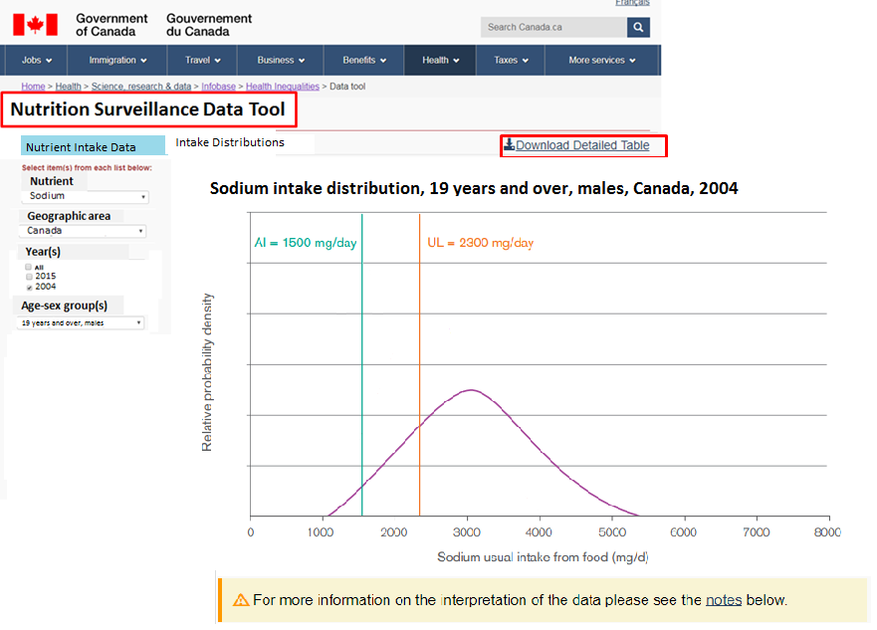
Notes:
Isabelle, do you think that “intake distributions” is the best title for the tab a user would select to move to the distribution graphs?
If both 2004 and 2015 are selected, we will need a legend or labels to indicate which curve is for which year.

